Slide 1
General Instructions
Delete this slide and green notes before finalizing presentation
Programs are allotted 60 min for Lead ID decisions.
Team should plan to present all key slides within 20 min and allow 40 min for discussion; assume the DPAC committee has reviewed the pre-reads..
We suggest ~15 slides within the main deck; back-up slides can be much more comprehensive.
One week prior to the meeting, deposit your presentation into the DPAC TeamNet folder so it can be reviewed by the committee: name_stage gate_date_preread
Final edits should be made by noon the day before the presentation and deposited in the DPAC TeamNet folder: program name_stage gate_date_showfile
Green notes throughout the this document provide instruction to the presenter and should be deleted before the slides are finalized.
The following slide deck provides a recommended organization structure for presentations, but team leaders should use their judgment to ensure that the presentation focuses on the key issues for a given program at its current stage:. bolded portions are stage gate requirements that must be included within the presentation deck or highlighted if missing at this stage.
As a best practice, teams should ensure full cross-functional alignment within the team regarding presentation content prior to DPAC.

Slide 2
Instructions – Outline for the Presentation
Delete this slide and green notes before finalizing presentation
Slide 1: Executive Summary: summary of full presentation
Slide 2: Summary of request being made from DPAC
Decisions requested
Resource requests (FTEs and $)
Slide 3: Therapeutic Concept
Slide 4-10: Data supporting the stage gate transition:
4. Biology
5. Pharmacology
6. Chemistry
7. Translational medicine
8. Safety
9. Clinical
10. Differentiation
Slide 11: Summarize stage gate criteria that have been met & outstanding gaps
Slide 12: Summarize strategy to Lead ID exit & Lead Op entry, including success criteria
Slide 13: Summarize timeline to next stage gate, present ‘accelerated’ option
Slide 14: Summarize resources to next stage gate, present resource for ‘accelerated’ option
Slide 15: Repeat Decisions requested, with heatmap illustrated
Slide 16: Team membership

Slide 3

HTT SM RNA Splicing Modulator
Lead ID Entry
NDRU
Catherine Guardado (RDPL) and Magnus Pfaffenbach (MedChem) on behalf of the HTT SM team
Modality: Small Molecule

Slide 4
Executive Summary
Program Goal | Develop best-in-class small molecule HTT RNA splicing modulator to decrease HTT protein expression and reduce toxic HTT aggregates to preserve cognitive and motor function
Molecular Hypothesis | Increasing poison exon inclusion via splicing will lead to a decrease in HTT mRNA via nonsense mediated decay. This in turn will reduce total HTT protein levels and as such reduce the potential for toxic aggregates to form.
Therapeutic Rationale | Reduction of total HTT expression will slow or stop disease progression and may potentially alleviate clinical symptoms associated with HD
Portfolio Fit | HTT SM program will expand on the current HTT targeting strategies at Biogen (MSH3, C4T degrader and Atalanta di-siRNA programs). The opportunity to target HTT at the mRNA level with a small molecule complements existing approaches and provides key modality advantages.
Target validation key findings and issues | Multiple literature reports, competitor patents, and internal in vitro & in vivo validation supports therapeutic hypothesis
Tractability Key Issues | Significant competition for the treatment of HD with a variety of modalities Determining how much knockdown is necessary in which brain regions to have a therapeutically meaningful effect with good tolerability

Slide 5
Decisions Requested Based on Hit ID Achievements
Stage gate Decision
Approval to enter Lead ID
Additional resources requested:
Hit ID Achievements
Identified 8 structurally diverse chemical series with potent (<100nM), on-mechanism protein/RNA lowering activity
Established SAR and viable path forward for improving ADME profile of compounds
Filed patent on top lead series; patent for second series in preparation
Initiated multiple approaches for MoA confirmation including RT-ddPCR, qPCR, and mini-gene reporter assays
Gained detailed understanding of off-target splicing events for competitor compounds in WT iPSC cells and NGN2 neurons via RNA-seq to determine benchmark selectivity for internal leads
Established initial understanding of off-target splicing liabilities for early leads and established plan for analyzing selectivity/safety of a broader set of lead compounds for purposes of differentiation
Initiated development of IV/IVC using known HTT splice modulator (PTC518) to benchmark PD/efficacy

Slide 6

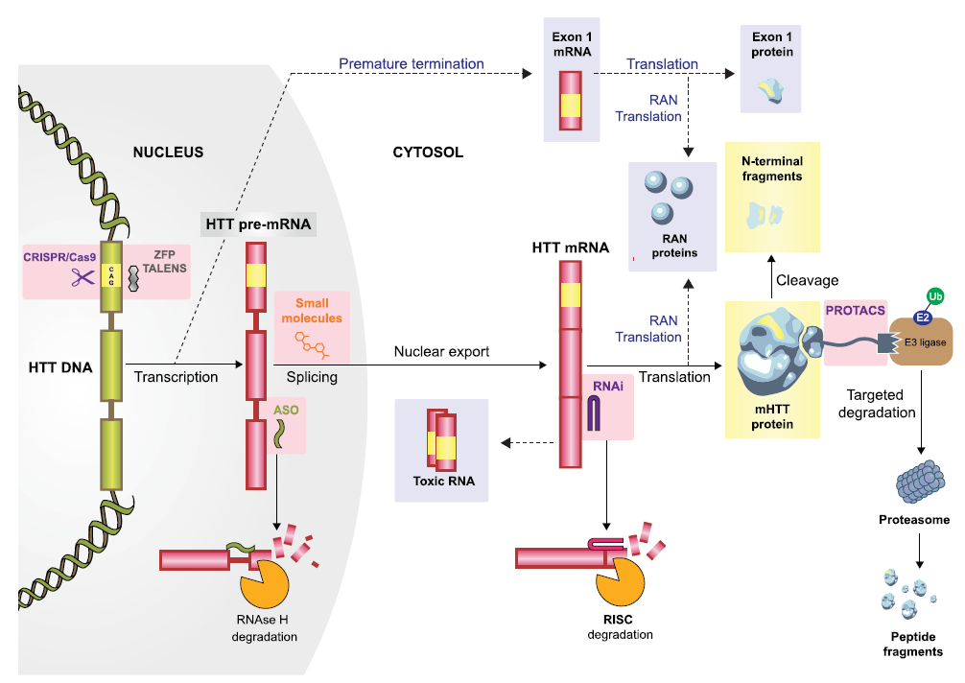


HTT splice modulator provides a unique modality advantage within broader internal HD strategy
Htt Splice Modulator (Oral, SM)
Lead ID Q2/2022
MSH3
RNA interference (Di-siRNA,IT)
Lead Q2/22
Htt Splice Modulator Competitor
Branaplan (Novartis, Ph1)
PTC 518 (PTC, PC)
MSH3 ASO
Triplet Therapeutics (PC)
Somatic
Expansion of CAG repeats
Htt Protein Degrader (Oral, SM)
Lead ID Q2/2022
GTx mHtt ZFP
TAK686
(Takeda/Sangamo, PC)
Htt Translation
(Oral, SM)
(Anima/Takeda, PC)
Htt ASO
WVE-120103
(Wave, Ph1)
Htt RNA interference (Di-siRNA,IT)
Lead Op Q2/22
GTx Htt shRNA
VY-HTT001
(Voyager, PC)
GTx Htt miRNA
AMT-130 (UniQure, Ph1/2
Htt Exon1 siRNA
ALN-HTT (Alnylam, PC)
Notes:
Red competition
Blue biogen
Animation: biogen, then all competition

Slide 7
Competitive Landscape Overview & Key Upcoming Catalysts
To be updated by Kelsey Taylor
Huntington’s Competitive Landscape*
Asset (Company) | Modality | RoA | Phase | Launch¹ | Selective | Upcoming Catalysts
1st Wave Of DMTs (2020-2025 Launches)
Tominersen (Roche / Ionis) | ASO | IT | Ph.3 | 2023-2024 | No | Topline Ph.3 data exp in 1H22; Ph. 1/2 OLE and HD natural history data exp 1H 2021²
2nd Wave Of DMTs (2025-2030 Launches)
WVE-120101 (Wave / Takeda) – SNP1 | ASO | IT | Ph. 1 / 2 | 2025 | Yes | Modified trial to include higher dose; results exp in Q1 2021³
WVE-120102 (Wave / Takeda) – SNP2 | ASO | IT | Ph. 1 / 2 | 2025 | Yes | Modified trial to include higher dose; results expected in Q1 2021³
AMT-130 (UniQure) | AAV5 GTx | Interstitial | Ph. 1 / 2 | 2026 | No | Early imaging and biomarker data from ongoing Ph.1/2 exp by YE 2021⁴
Branaplam (Novartis) | SM | PO | Ph. 1 | 2025-2030 | No | Ph.1 results expected 1H 2021; Ph.2b to start 2H 2021⁵
PTC-518 (PTC) | SM | PO | Ph.1 | 2025-2030 | No | Ph.1 SAD / MAD in HV study ongoing; results expected in 1H 2021⁸
WVE-120103 (Wave / Takeda) – SNP3 | ASO | IT | Ph.1 | 2025-2030 | Yes | Ph.1b/2a (N=~40) to start in 1H 2021⁶
VY-HTT001 (Voyager) | AAV1 GTx | TBD | Preclinical | 2025-2030 | No | CMC clinical hold placed; Voyager plans to submit response to FDA 1H 2021⁷
3rd Wave Of DMTs (2030+ Launches)
TAK 686 (Sangamo / Takeda) | ZFP GTx | TBD | Preclinical | 2030+ | Yes | Takeda plans to evaluate drug candidate in IND-enabling studies; no timeline given⁹
DDR ASO (Triplet) | ASO | IT | Preclinical | 2030+ | N/A² | IND Submission planned for 2H 2021¹⁰
ALN-HTT (Alnylam) | ASO | IT | Preclinical | 2030+ | No | Candidate selection ongoing; no timeline given¹¹
SPK-miHTT (Spark / Roche) | GTx | TBD | Preclinical | 2030+ | No | N/A
HTT ASO (Biogen / Atalanta) | ASO | IT | Preclinical | 2030+ | No | IND Submission planned in 2022
*Table highlights select competitors and is not an exhaustive list
Notes:
Based on IQVIA Forecast Link and analyst estimates; to be further validated
IONIS JP Morgan Presentation; Jan 2021: “As for the open-label extension data that Roche will present, they actually haven't put down -- out the timing yet for when they're going to talk about that. They have presented (technical difficulty) meetings every spring. So it's a good possibility that it will be in the first half of this year as well as the natural history data.”
WAVE Q4 2020 Earnings Call; March 21: “These include biomarker and safety data from all cohorts of Precision-HD2 core trial, including the 32-milligram cohort, along with all complete cohorts up to and including the 16-milligram cohort from the Precision-HD1 court trial. We will also share data from the patients who have received multiple doses of 8 or 16-milligram from the 60 milligram WVE-120101 and WVE-120102 in the open-label extension trials.”
Truist Securities Report; March 2 2021
Novartis Q4 2020 Earnings Call; Jan 2021: “Specifically on branaplam, as you highlighted, we will get the Phase I results in the first half of this year. With those results, what we intend to do is take it to the health authorities and have discussions. And if time lines allow, we certainly will move as quickly as possible. If it's realistic, we will absolutely have Phase IIb in the first half of this year. but it really depends on the feedback from the health authorities because we will have to have discussions both with the FDA as well as European agencies.”
Jefferies Report: March 4 2021
Voyager Q4 2020 Earnings Transcript Feb 21: “For the Huntington's program, we expect to provide our response to the FDA on our IND in the first half of the year and to initiate our first-in-human trial upon IND acceptance.”
Credit Suisse March 4 2021 Report
Cowen March 19 2021 Report
https://www.businesswire.com/news/home/20200721005209/en/Triplet-Therapeutics-Selects-Clinical-Candidate-for-Novel-Treatment-of-Repeat-Expansion-Disorders
Alnylam 2020 R&D Day Transcript: “Here, we are looking towards a differentiated strategy that lowers the very important exon 1 fragment. We continue our progress in this program towards a development candidate, along with many other targets for important diseases of the CNS.”

Slide 8
Target Product Profile
To be updated by Kelsey Taylor
Pre-Read
Attribute |  | MPP | TPP
Value Proposition |  | Best-in-class, transformational standard of care therapy that reduces HTT protein levels to significantly reduce signs and symptoms of Huntington Disease and delay disease progression | Best-in-class, transformational standard of care therapy that reduces HTT protein levels to eliminate signs and symptoms of Huntington Disease and stop disease progression
Indication |  | Treatment of Huntington Disease | Treatment of Huntington Disease
Target Patient Population |  | HD patients with 1 HTT allele with >36-40 CAG repeats of any age. Mild-moderate manifest symptomatic HD patients. | HD patients with 1 HTT allele with >36-40 CAG repeats of any age. Mild-moderate manifest symptomatic HD patients.
MOA |  | Reduction of total HTT protein via alternative splicing of mRNA. | Reduction of total HTT protein via alternative splicing of mRNA.
Pivotal Trial Design |  | RCT, HD patients with 1 HTT allele with >36-40 CAG repeats of 25-65 years old. Mild-to-moderate manifest symptomatic HD patients. | RCT, HD patients with 1 HTT allele with >36-40 CAG repeats of 25-65 years old. Mild-to-moderate manifest symptomatic HD patients.
Primary Efficacy Endpoint(s) |  | Change from Baseline in the Composite Unified Huntington's Disease Rating Scale (cUHDRS) Change From Baseline in the Total Functional Capacity (TFC) Score | Change from Baseline in the Composite Unified Huntington's Disease Rating Scale (cUHDRS) Change From Baseline in the Total Functional Capacity (TFC) Score
Secondary Efficacy Endpoints |  | Change From Baseline in Total Motor Score (TMS) [ Time Frame Change From Baseline in Symbol Digit Modalities Test (SDMT) Change From Baseline in Stroop Word Reading (SWR) Change From Baseline in the Clinical Global Impression, Severity Scale (CGI-S) | Change From Baseline in Total Motor Score (TMS) [ Time Frame Change From Baseline in Symbol Digit Modalities Test (SDMT) Change From Baseline in Stroop Word Reading (SWR) Change From Baseline in the Clinical Global Impression, Severity Scale (CGI-S)
Exploratory Endpoints |  | Quality of life measure (TBD) Slowing of CSF NfL elevation Change From Baseline in CSF tHTT Protein Level | Quality of life measure (TBD) Stopping of CSF NfL elevation Change From Baseline in CSF tHTT Protein Level
Safety & Tolerability |  | Clinically manageable mild to moderate. No worse than standard of care (Antidepressants/Antipsychotics e.g., citalopram/quetiapine). | Clinically manageable mild to moderate.
Product Experience | ROA & Dosing | 2 x daily (oral) | 1 x daily (oral)
 | Patient Management and Monitoring | Post-treatment initiation monitoring requirements per label comparable in burden to other available DMTs | No post-treatment initiation monitoring requirements per label; No REMS

Slide 9
Biology
Document key preclinical data linking target to disease.
Describe understanding of target distribution.
Re-evaluate literature to understand safety or efficacy phenotypes reported for relevant mouse models.
Ensure genetically modified animal models have been requested
Update knowledge gaps and prioritize.
Notes:
This is an example of how you could highlight what we know an don’t know in summary format?

Slide 10
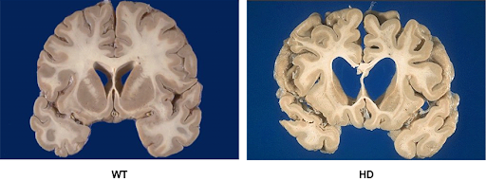
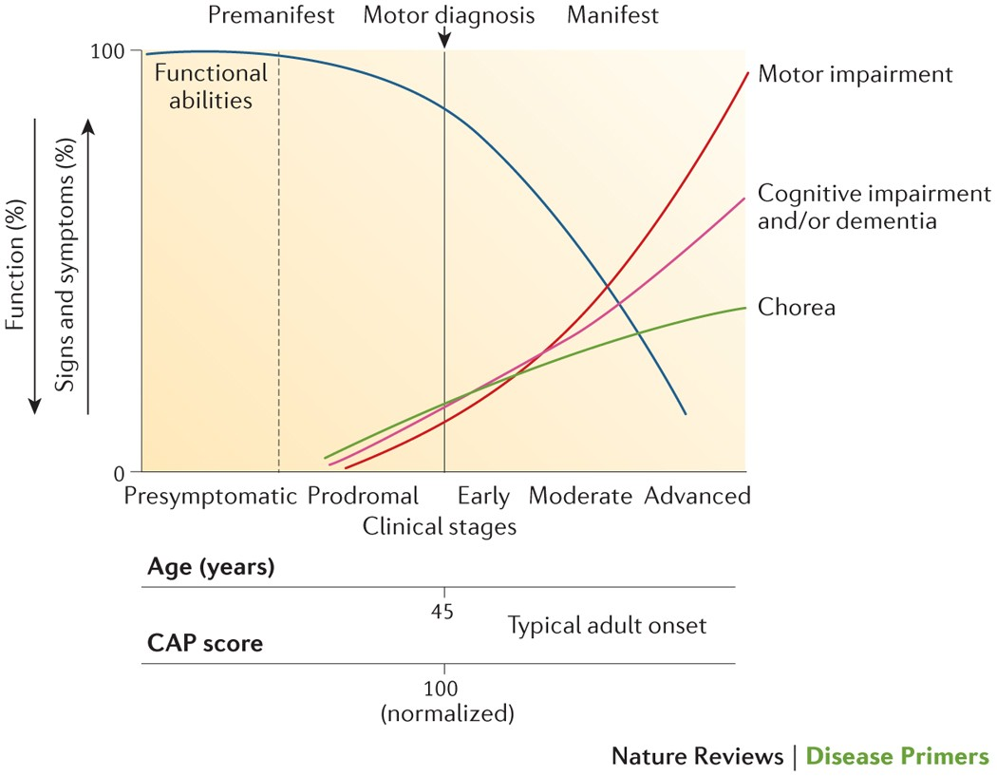
Huntington’s Disease
Pre-Read
Huntington’s Disease (HD) is an autosomal dominant neurodegenerative disorder manifesting as motor, behavioral, and cognitive symptoms
Profound degeneration of medium spiny neurons in striatum, but the cerebral cortex, other brain regions and the periphery are also affected
HD is caused by an expansion in the number of CAG repeats (encoding poly Q tract) in the first exon of the HTT gene
Prevalence in Western hemisphere is ~7-10/100,000
30,000 HD patients in US and 150,000 at risk
Mean age of onset is ~ 40, survival time after diagnosis is ~20 years
Disease Cause:
HTT gene with
≥40 CAG repeats
Increased CAG repeats
Chr 4
Htt gene
Control
HD
Caudate
Putamen
Bates et al, 2015
Notes:
HD also causes systemic issues including metabolic, muscular and cardiac impairments
HD is caused by an expansion in the number of CAG repeats (encoding poly Q tract) in the first exon of the HTT gene
Uninterrupted CAG repeat lengths correlates with onset and rate of clinical progression better than poly Q length
Many genetic modifiers of disease onset and progression affect somatic expansions of CAG repeats

Slide 11
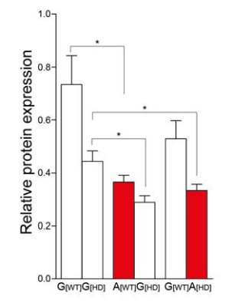
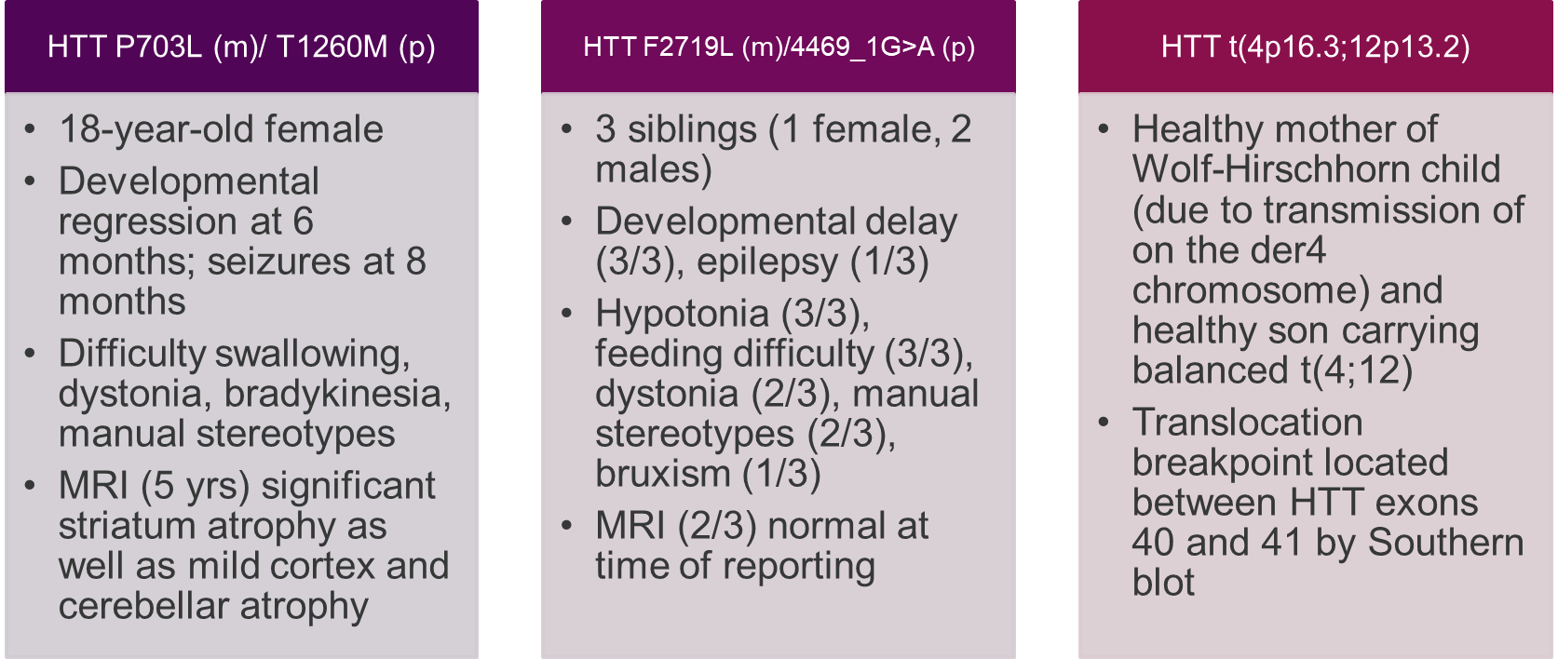
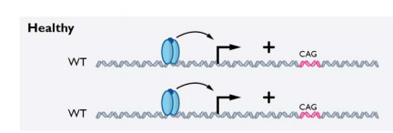
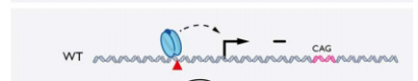
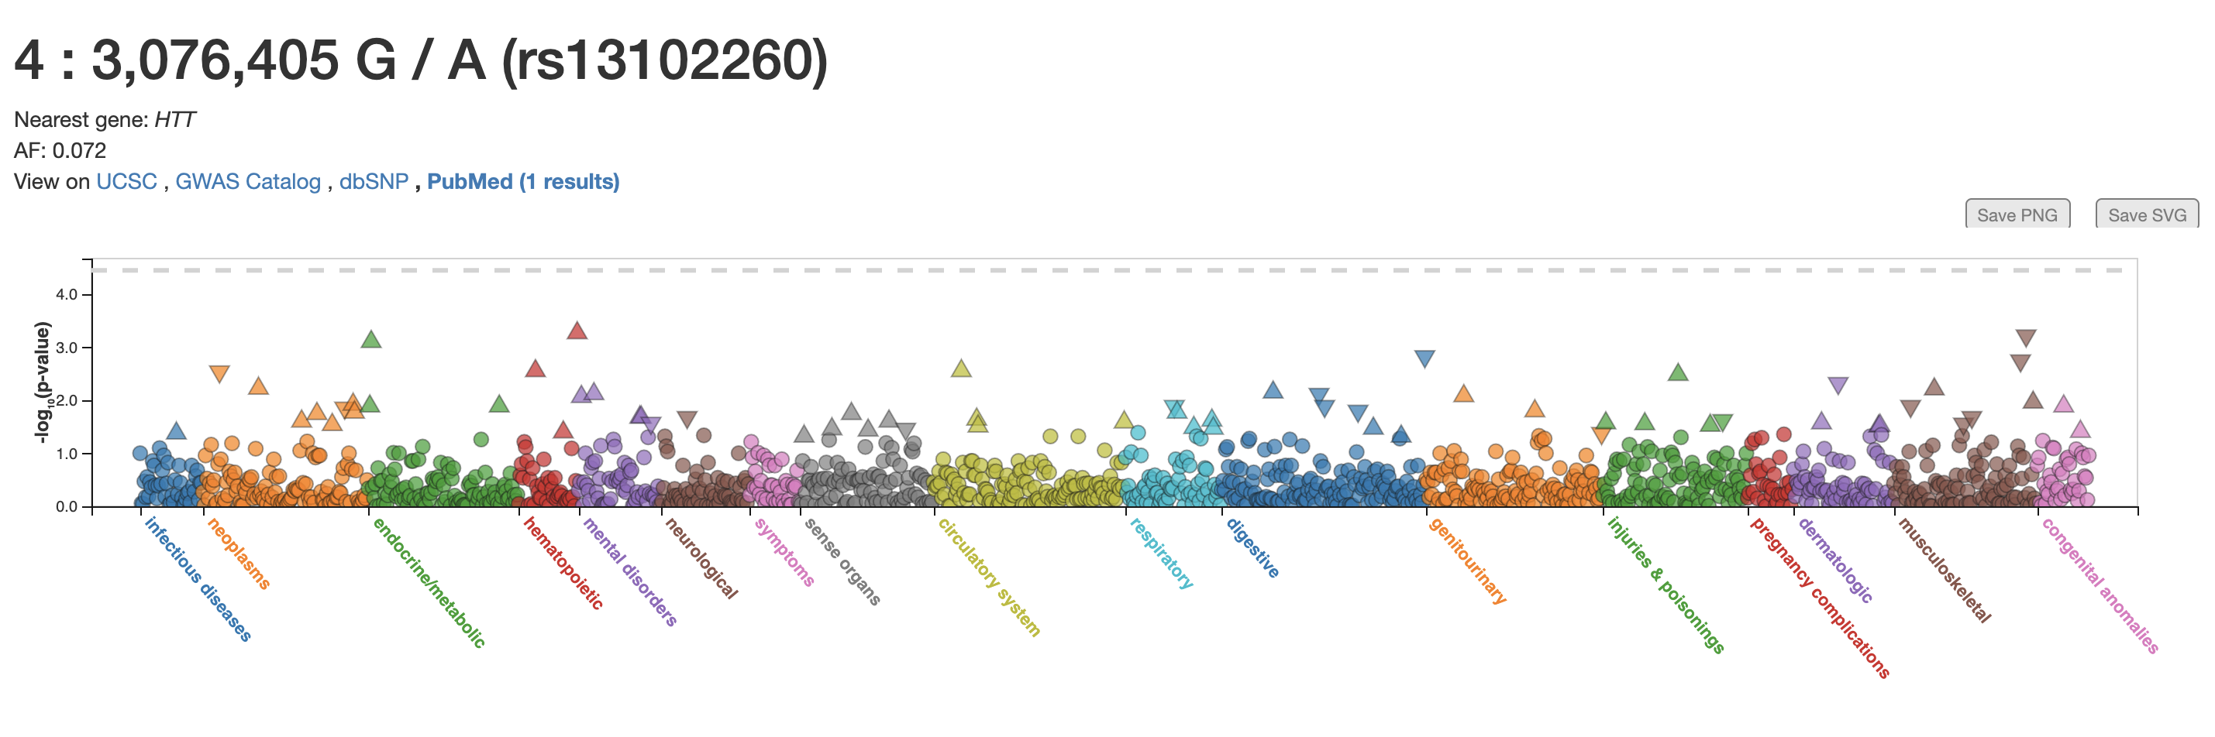
Human genetic data suggests that up to a 70% reduction in HTT is tolerated
Chris Whelan to update
Include comments on pan vs. allele-specific approaches
Include evidence supporting tolerability of lowering X% in adults
HTT promoter SNP rs13102260 reduces protein by ~60%
Compound HET missense mutations in HTT
Balanced translocation
Include any new internal iPSC data here
Healthy
Healthy – reduced HTT
PheWAS (UKB): No disease association
HTT protein level
~2300 AA homozygotes
0%
30%
50%
therapeutic target
100%
Embryonic lethal
pLI=1
Phenotypically normal
In mice: 50% Htt LoF is compatible with generally normal development and function
Ambrose Som Cell Mol Genet 1994, 20(1):27-38
Lopes J Med Genet 2016 doi: 10.1136/jmedgenet-2015-103568
Rodan Euro J Human Genet 2016 doi: 10.1038/ejhg.201674
Becanovic Nat Neurosci 2015 doi: 10.1038/nn.4014
Notes:
In mice: 50% Htt LoF is compatible with generally normal development and function
Constitutive Htt KO is embryonic lethal in mice but few or no reported HET phenotypes
Nasir et al. 1995 Cell; Zeitlin et al. 1995 Nat Genet; Buyao et al. 1995, Science
>50% LoF of Htt in adult neurons does not lead to dysfunction or neurodegeneration
Wang et al. 2016 PNAS
>50% but <100% LoF of Htt in early postnatal forebrain may lead to forebrain tissue loss with time
Dragatsis et al. 2000 Nat Genet
Genotype at rs13102260 drives allele-specific expression of HTT. The effect of the rs13102260 (A) sequence variant on wild-type and mutant HTT (mHTT) protein expression levels was measured with western blot analysis in HD patient fibroblast lines. Wild-type HTT protein was reduced in the samples with the (A) variant phased to the wild-type allele compared to the (G) variant (G[WT] vs A[WT]) (t(6) = 3.27, P = 0.0169, two-tailed unpaired t-test). mHTT protein was reduced in the samples with the (A) variant phased on the HD disease allele compared to the (G) variant (G[HD] vs A[HD]) (t(6) = 2.46, P = 0.0495). We observed a general reduction of mHTT protein compared to the wildtype protein regardless of genotype. The mHTT protein in the A[WT]G[HD] fibroblast lines was expressed at lower levels compared to the G[WT]G[HD] (t(6) = 3.36, P = 0.0152). The data represents two different fibroblast lines per genotype group including two pellets per cell line (mean ± s.e.m, n = 4). Alleles carrying the rs13102260 (A) sequence variant are labelled in red; (G) variant carriers are indicated in white. For each genotype group, the left bar indicates wild-type HTT levels, and the right bar indicates mHTT levels.
Expanded CAG allele (with G) has reduced expression (~50% of normal CAG (with G) allele expression)
“A” variant reduces HT expression by ~60% on normal CAG allele.
Carriers of two “A” variant alleles would be expected to have ~16% (0.4x0.4) HTT expression of carriers of two “G” variant alleles.
The data from the western blot suggests that effects of the “A” variant and an expanded CAG repeat are not additive as “A” variant with normal CAG repeat and “A” variant with expanded CAG repeat have the same expression level.
Given that the variant is in the promoter of the gene, cell type context may influence expression level.

Slide 12

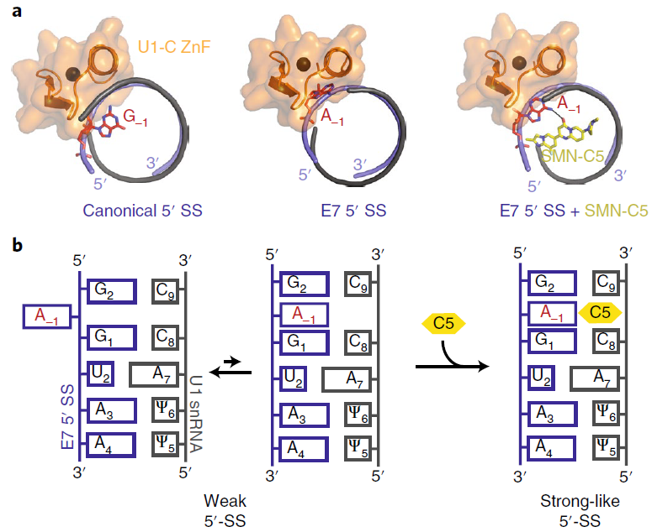
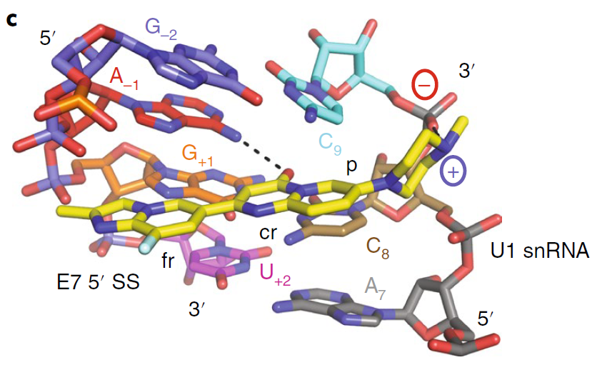
Molecular hypothesis for SM splice modulators
HTT is a high value genetic target that is amenable to modulation via splicing
Splicing correction (5ʹ-SS bulge repair)
SM splice modulator stabilizes an unpaired adenine
at the exon–intron junction in the RNA helix
RNA conformational switch makes minor groove accessible and allosterically promotes binding of the U1C zinc finger and U1 snRNP
SM splice modulator matches a unique pre-mRNA/U1 interface and serve as molecular glue to help initiate splicing events
49
49N
50
HD patient with >40 CAG:
Leads to toxic HTT protein
Stop
codon
No Drug
+ Drug
49
50
49
49N
50
Canonical splicing
Poison exon not spliced in
SM defines portion of intron as exon
Inclusion of poison exon
leads to HTT mRNA decay
Key structural requirements of a SM splice modulator
1) Central ring inserts between C8/C9 (H-bond with NH₂ of adenine)
2) Positively charged amine (ribose backbone of U1 snRNA)
Small
molecule
Adenine
bulge
Notes:
HTT mRNA included a previously unreported 115 nt derived from part of intron 49, just after the end of exon 49
The spliceosome assembles in a stepwise manner from five snRNPs, each containing a small nuclear RNA (snRNA) (U1, U2, U4, U5, or U6), and then undergoes an extensive remodeling process to form its active site
No drug: unpaired adenine at -1 position causes clash with protein

Slide 13
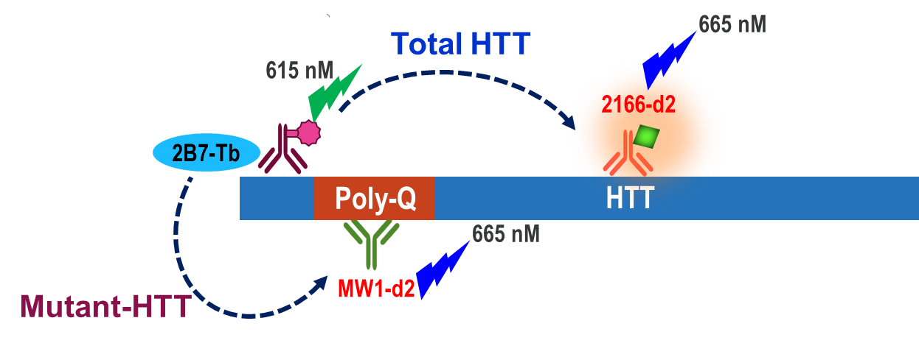
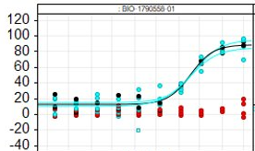
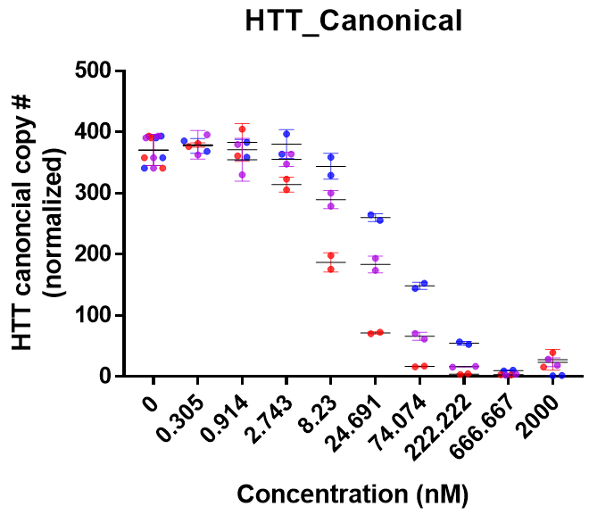
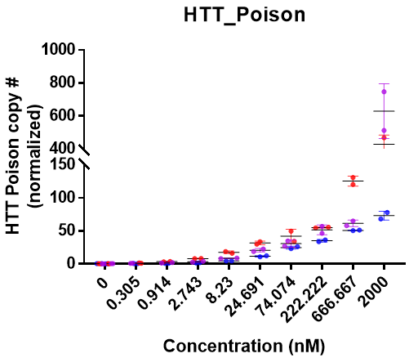
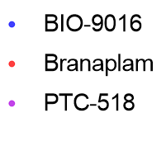
Assays for potency determination & on-mechanism validation
dd-PCR splicing assay for measurement of
HTT poison exon inclusion (A431 cells)
Cell based wtHTT and mHTT HTRF assay for
profiling compounds in patient iPSCs (Q48/17)
Increasing poison exon inclusion / decreasing canonical splicing translates to decreased HTT protein
Fwd
Rev
Control
48
49
50
51
Probe
Fwd
Rev
Splice Modulator
48
49
50
51
Probe
CTG mHTT​ tHTT​
Well-established assay with direct measurement of protein of interest
High throughput (screened 12k compounds at CRL at single 10 uM conc)
Counter screen: CellTiter-Glo Luminescent cell viability assay (CTG)
→ Transferred and setup internally (IC50 generation started Dec 2021)
Joe Santoro
Joon Lee
Viraj Shah
Notes:
Induced pluripotent stem cells
epidermoid carcinoma cell line A-431

Slide 14
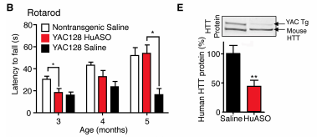
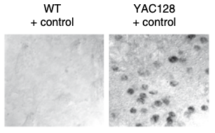
hHTT distribution reflects endogenous HTT in human and mouse
Mouse model for assessing PD and efficacy of human HTT lowering compounds
YAC128 mice display several important pathologies that are also observed in HD patients
Codes for the entire human HTT on a yeast artificial chromosome (YAC) under control of the human promoter
Higher amount of uninterrupted CAG repeats (93% CAG, 7% CAA) than BACHD model (49% CAG, 49% CAA)
mHTT aggregates present
1 graph containing hHTT/mHTT RNA - Neeta
1 graph containing hHTT protein - Andreas
Striatal atrophy at 12 mo
Motor impairments at 3 mo
Internal PD validation of PTC518 in the YAC128 mouse model
Kordasiewicz, 2012
Nucleoplasmic Htt inclusions in
striatum at 12 mo
Update with PD study #2 data (24h timecourse, 3mpk only)
- Combine canonical/Poison graphs into one → one for blood, one for ctx
Okamoto, 2009
Control
YAC128
14
Notes:
Such models express human genomic mutant HTT transgenes, including all the introns and exons as well as the regulatory sequences up to 24 kb upstream and 117 kb downstream of the gene, ensuring appropriate temporal and tissue-specific expression of mHTT
YAC128 HD mice express mutant HTT with 128 CAG repeats54, whereas BACHD mice and rats express mutant HTT with 97 CAG repeats55,56. The YAC128 and BACHD mice show limited somatic and germline repeat instability (V. Wheeler, personal communication)55.
Although the BACHD and YAC128 models share many phenotypic characteristics, there are notable differences between them, including divergent neurochemical and aggregation phenotypes60.

Slide 15
Differentiation Strategy
Confirm that Therapeutic Concept is consistent with disease area roadmap, where available.
Provide updated competitive intelligence in target area and disease.
Provide a competitive intelligence assessment for hit series.

Slide 16
HTT Splice Modulator Triage Strategy
Prioritized RNA library
Inspired Design Compounds
1º SAR driving assay
Primary assay / Counter Screen
HTT protein assay
iPSC HTRF Q48
Cellular viability readout
CTG iPSC Q48
1º Counter-screen
MoA Confirmation
RT-ddPCR HTT splicing assay
A431 cells
Med Chem
BHTS
PreClin Safety
Research
PhysBio
TB
HepG2 cytotox
MDR1/BCRPER, Kp_{u,u} Rat
Pk_{a}
In vitro/vivo ADMET
hERG
CYP
Targeted RT-ddPCR OT analysis of FOXM1/GALC/MADD
RASL-seq IC50 OT analysis
Selectivity
Parallel (non-gating)
Secondary Confirmation
RNA-seq OT analysis in iPSC/NGN2
HTT protein and qPCR assays: HD NGN2/LCL
HTT protein assay: IPSC HTRF
(additional polyQ lengths)
PK/PD
PK/PD in YAC128 HD Mouse
Biophysical assessment of SM association with U1 snRNP/5’ss
HTT Mini-gene reporter assays
Ames
Safety panel
Hurel liver tox
Safety / Tolerability
Phototox
KinomeScan
Micronucleus
Phospholipidosis
DRF mouse tolerability

Slide 17
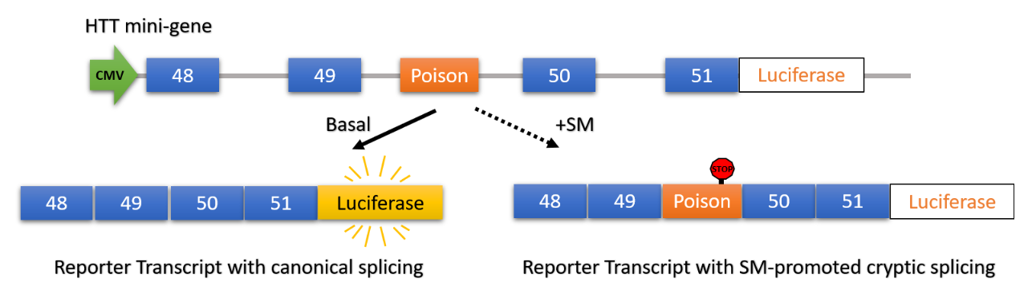
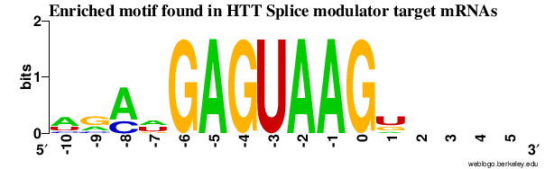
Two-pronged approach to understand selectivity and increase potential for differentiation
Transcriptomics
# of total and safety-linked DSGs
HTT selectivity window
ID any selectivity-associated SAR
MoA studies
ID different enriched splice site motifs
ID HTT binding sequence/location
ID important binding elements outside of 5’ss
Complement panel with emerging transcriptomic data (100 cmpd profiling)
PTC518/Branaplam transcriptomics in iPSC / NGN2
-> ID OTs
HTT binding assay image - Linlong
Send list of DEG/DSG to preclinical safety
Design probes for RASL-seq
Mini-gene reporter image
Identify genes for further follow-up and selectivity focus
Assess compound dose-response against panel in RASL-seq
Cell type: ??
X cpds/run in X-pt dose-response
5’ss motif image
- ID any SAR for improved selectivity - ID candidates for RNA-seq

Slide 18
Branaplam and PTC518 benchmark RNA-seq data analysis
Could come before “2 pronged approach slide”

Slide 19
Chemistry
Describe chemistry plan:
Compounds exhibit adequate intrinsic potency or established SAR suggesting a viable path forward for improving activity.
Representative compounds from the chemical series profiled for solubility, permeability and efflux, in vitro microsomal stability, plasma protein binding, and chemical stability at low pH.
Representative validated hits evaluated for selectivity.
Hit series is synthetically modular.
Scale up routes to access multi-gram quantities of key intermediates and building blocks available.
In silico SAR enabling strategy is in place and predictions for physical chemical and ADME properties of lead series are available

Slide 20




Competition for HTT SM splice modulator is high
11 WO & US Patents
11 WO & US Patents
4 WO Patents
>100 competitor compounds have been synthesized and profiled to identify their lead candidates

Slide 21
Differentiation from clinical stage competitors
Aberrant FOXM1 & MADD splicing found
in studies with risdiplam hypothesized as
source of micronucleus formation
Branaplam has limited brain exposure and is less selective than risdiplam
(18 off-targets at 10x SMA IC50)
Prominent secondary splice targets due to high splice site similarity across genes
HTT : AGCAGA|GTAAGGGGGC
SMN2 : TAAGGA|GTAAGTCTGC
FOXM1 : ACATGA|GTAAGTTCTT
MADD : AACAGA|GTAAGGAACA
STRN3 : TGAAGA|GTAAGTGCAG
APLP2 : CGATGA|GTAAGTCCTG
SLC25A17: AGATGA|GTAAGATTAG
Specific Measure | BIO-1755497 (LMI070, Branaplam)
HTT Protein / RNA lowering IC50 | 12 nM / 5 nM
MDR1-MDCK / BCRP Efflux ratio [Papp_{A→B}] | 29 / 1.4 [16.6]
Rat Kp_{uu} | 0.11
hERG / [GLU, GAL] IC₅₀ (µM) | 4.7 [0.07, 0.6]
Eurofins Safety Panel (off-targets <1 µM) | ROCK1: 0.58 µM
Number of differentially spliced genes (iPSC) | 66 (4x IC50)
FOXM1 off-target splicing IC50 | 53 nM (11x)
MADD off-target splicing IC50 | 67 nM (14x)
Human dose (phase 2 dose finding study) | 56-154 mg weekly
MW / cLogP / PSA / pka / cnsMPO | 393 / 3.2 / 96 / 10.1 / 3.5
BIO-2006152 (PTC518 guess)
12 nM / 16 nM
5.8 / 1.3 [42]
0.9
>30 / [0.04, 0.31]
AChE: 0.33 µM
44 (4x IC50)
66 nM (4x)
165 nM (10x)
5-10 mg QD
390 / 2.9 / 59 / 9.3 / 5.1
Safety and selectivity are the key areas to differentiate and beat competition:
1) Improve cytotoxicity to reasonable margin
2) Reduce the number of off-targets to minimize
risk of toxicity
3) Improve selectivity over FOXM1 & MADD to reduce the risk of micronucleus formation

Slide 22
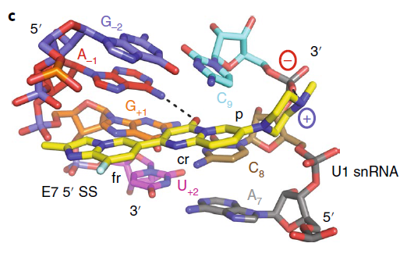
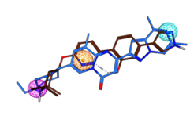
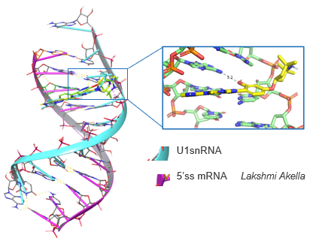
HTT strategy to identify novel IP within crowded field
(1) Inspired design
(2) Biogen’s RNA library
(3) CRL Screening results
Structure & Ligand Based Design
Single Conc mHTT HTRF assay
(HD Q48 hES cells at 10 µM in duplicate)
12,423
362
168
38
9
Branaplam
Risdiplam
≥30% mHTT lowering in both replicates
over CTG
Utilize known NMR and crystallographic information from RNA-SM complexes to highlight important features for binding
HTT docking model to prioritize compounds for synthesis
favorable
Biogen IP
on-mechanism
splicing activity
(0.30% hit rate)
structurally
distinct series
Custom Designed Libraries (6400 compounds)
Commercial RNA Collections (5000 compounds)
HTT specific (2600 compounds)

Slide 23
Imidazopyridine & thienopyridine leads are amenable for parallel optimization
Imidazopyridines
300 analogs made
Fluoride-adenine interaction
Patent filed in April 2022
Thienopyridines
88 analogs made
Carbonyl-adenine interaction
Patent in preparation
Specific Measure | BIO-2060571
Protein / RNA lowering IC50 | 300 nM / xx nM
R,HLM / R,Hheps Cl (mL min⁻¹ kg⁻¹) | <10.7, <4.7 / <5.3, <2.4
MDR1 / BCRP Efflux ratio [Papp_{A→B}] | 13.8 / 9.5 [5.7]
hERG / [GLU, GAL] IC₅₀ (µM) | 22.7 / [0.67, >30]
MW / cLogP / PSA / pka / cnsMPO | 349 / 2.9 / 47 / 10 / 4.8
Specific Measure | BIO-2162552
Protein / RNA lowering IC50 | 338 nM / xx nM
R,HLM / R,Hheps Cl (mL min⁻¹ kg⁻¹) | 177, 13 / 71, <2.4
MDR1 / BCRP Efflux ratio [Papp_{A→B}] | 22 / 21 [9]
hERG / [GLU, GAL] IC₅₀ (µM) | 2.0 / [30,30]
MW / cLogP / PSA / pka / cnsMPO | 420 / 3.3 / 65 / 7.0 / 3.6

Slide 24
More potent, brain penetrant & selective imidazopyridines discovered
Specific Measure | BIO-2060571
Protein / RNA lowering IC50 | 300 nM / xx nM
MDR1-MDCK / BCRP ER [Papp_{A→B}] | 13.8 / 9.5 [5.7]
hERG / [GLU, GAL] IC₅₀ (µM) | 22.7 / [0.67, >30]
BIO-2060884
136 nM / ip nM
1.8 / 1.7 [65]
>30 / [>30,>30]
BIO-2172267
50 nM / ip nM
5.1 / xx [7]
>30 / [ip]
BIO-2139701
33 nM / 19 nM
23.1 / 37 [8]
>30 / [>30, 0.66]
BIO-2060881
11 nM / 6 nM
15.4 / 17 [6]
>30 / [0.10, 0.31]
High IV clearance
due to FMO1 forming
N-hydroxyl metabolite
Specific Measure | BIO-2060881
Protein / RNA lowering IC50 | 11 nM / 6 nM
MDR1-MDCK / BCRP ER [Papp_{A→B}] | 15.4 / 17 [6]
hERG / [GLU, GAL] IC₅₀ (µM) | >30 / [0.10, 0.31]
BIO-2162548
110 nM / nd
1.2 / 0.3 [14]
>30 / [nd]
BIO-2178776
xx nM / ip nM
3.3 / 4.3 [7]
Xx / [0.91, 1.7]
BIO-2186482 (rac)
xx nM / ip nM
10.9 / xx [30]
>30 / [xx, xx]
BIO-2175420
xx nM / ip nM
3.1 / 1.0 [91]
26 / [xx, xx]

Slide 25
Related 5,6-bicyclic cores are promising leads (data coming, will change)
Specific Measure | BIO-2186527
Protein / RNA lowering IC50 | X nM
FOXM1 off-target splicing (IC50)
R,HLM / R,Hheps Clint (mL min⁻¹ kg⁻¹)
MDR1-MDCK / BCRP ER [Papp_{A→B}] | 1.8 / 3.6 [92]
Solubility pH 6.8 (µg/mL) [ElogD]
hERG / [GLU, GAL] IC₅₀ (µM)
MW / cLogP / PSA / pka / cnsMPO
BIO-2176866
50 nM /76 nM
726 nM (10x HTT)
<10, 4 / <10, <5
1.2 / 1.3 [16]
29 [0.7]
>30 / [2.7, 5.9]
364 / 2.9 / 71 / 9.2 / 4.9
BIO-2185962
xx nM
-
x
BIO-2174748
In progress
-
<10, <5 / 39, 7
16 / nd [17]
150 [1.4]
2.1 / [0.01, 0.9]
365 / 2.8 / 68 / 9.7 / 4.9
Benzimidazole
analog formation
in progress (focus on LHS)
N-linked LHS amines are in progress via S_{N}Ar

Slide 26
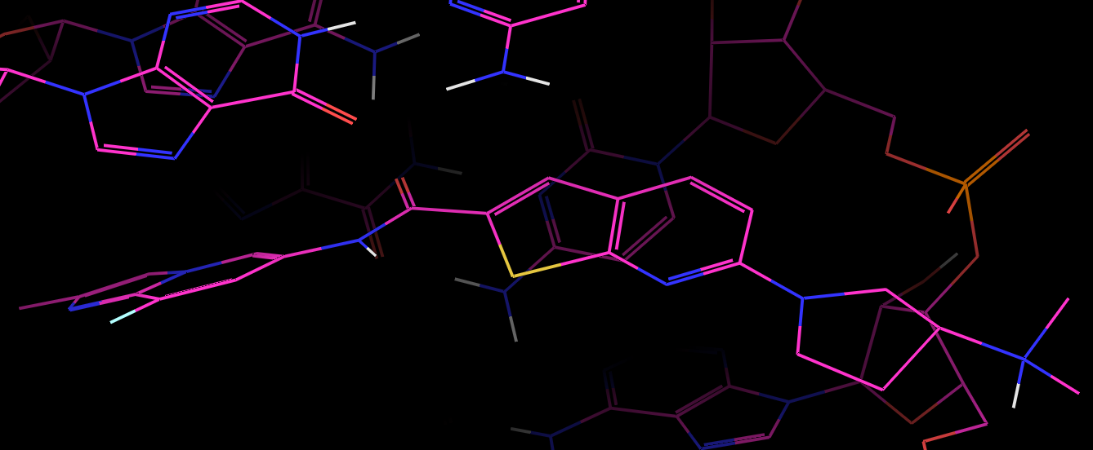
Thienopyridine scaffold has striking selectivity over FOXM1 & MADD
without F
Specific Measure | BIO-2184088
Protein / RNA lowering IC50 | 21 nM / 11 nM
FOXM1 off-target splicing IC50 | 227 nM (21x HTT)
MDR1-MDCK / BCRP ER [Papp_{A→B}] | 15.3 / 14.2 [18]
hERG / [GLU, GAL] IC₅₀ (µM) | 3.1 / [xx, 1.34]
MW / cLogP / PSA / cnsMPO | xx
BIO-2184090
96 nM / xx nM
xx nM (xx HTT)
5.7 / 1.4 [41]
22.2 / [ip]
xx
BIO-2162224
50 nM / 26 nM
873 nM (34x HTT)
13.5 / xx [12]
2.0 / [xx, xx]
xx
Fluoride substitution gives 16-fold potency improvement
Nitrogen masks
amide N-H & improves efflux
→ Kpuu: ip
More potent LHS discovered

Slide 27
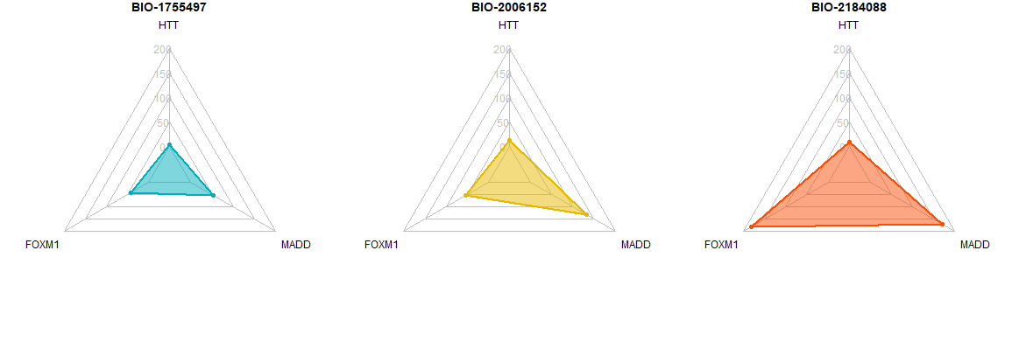
IC50 radar plots : the three SMs have comparable HTT IC50 values, but the IC50 values of FOXM1, MADD are different.
Feel free to delete or move to the backup - Joon

Slide 28
Pharmacology
Demonstrate that hits have been fully validated.
Demonstrate that compounds from similarity searches have been fully validated.

Slide 29
Safety Assessment
Highlight data on validated hits that have been evaluated using in silico tools to look for potential safety alerts and toxicophores.
Describe any non-standard assays that could mitigate identified safety risks.

Slide 30
To be updated by Colin Choi
Target Safety Assessment: HTT (Splicing Modulator)
Project Hypothesis/Goal | Small molecule splicing modulator increasing poison exon to reduce HTT mRNA and Htt protein for Huntington’s Disease (HD)
Target Biology | Polyglutamine (PolyQ) expansions in exon 1 of the HTT gene leads to autosomal dominant disorder (>36 repeats). Htt protein produced with PolyQ expansions increases cytosolic protein aggregation, which in turn induces numerous cellular dysfunctions associated with HD, including dysregulated transcription, mitochondrial toxicity, axonal transport impairment, and synaptic defects. Untranslated CAG repeat transcripts may also induce cytotoxicity.
Genetics | KO mice (homozygous) - embryonic lethality at E8.5 (abnormal gastrulation¹⁻², acute pancreatitis³); deletion in adult mouse (> 8 months) does not cause neurodegeneration or death³ KO mice (heterozygous) – normal phenotype at 4 months¹⁻²; increased motor activity and some cognitive deficits (memory)². Morphological changes in the brain include decreased volume of the subthalamic nucleus and the total number of subthalamic neurons².
Tool/Competitor compounds | Multiple competitions for HD, including splicing modulators (PTC, Novartis), ASO (Wave/Takeda), GTx (Sangamo/Takeda, Uniqure, Voyager)
Potential safety risks | Potential changes in motor activity and cognitive abilities as well as neurodevelopment if normal Htt functions are targeted and reduced (other unclear toxicities may also manifest) Off-target effects due to selectivity – some may be comparable to toxicity reported with risdiplam (if research strategy is to utilize risdiplam/branaplam as references), such as retinal degeneration and suggestions of genotoxicity
Testing strategy | Early off-target assessments to optimize selectivity and strategize de-risking approaches Evaluate brain phenotype and conduct neurobehavioral testing (timing of when to include should be discussed) Explore/test for retinal degeneration (if compound is the same class as risdiplam) and genotoxicity – consider utilizing predictive software to screen for mutagenicity at early stage, followed by in vitro assays at later stages
Duyao+ 1995
Nasir+ 1995
Wang+ 2016

Slide 31
Clinical Strategy
Describe clinical tractability updated by RU clinical lead in consultation with appropriate partner line representatives.
Document availability/need for Natural History or other external data prior to Phase 2.
Document Secondary Indications: Scope of work required to support selection.
Define proposed clinical Proof of Concept endpoints.
Evaluate status of potential registrational endpoints required to support regulatory approval.
Share QMP updated by QM representative and RU Clinical and Biomarkers lead.

Slide 32
Translational Medicine
Share the translational medicine plan, which has ideally been reviewed at CERB.
Define plans to demonstrate preclinical and clinical TE and PD. If the preclinical biomarker is unsuitable for clinical development then a secondary biomarker must also be identified for use in humans.
Describe published or internal pharmacometric modelling.
For targets with genetic support, describe resources needed to refine genotype-phenotype associations and prevalence of rare mutations.

Slide 33
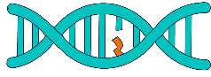
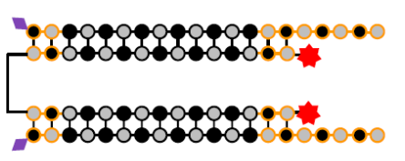
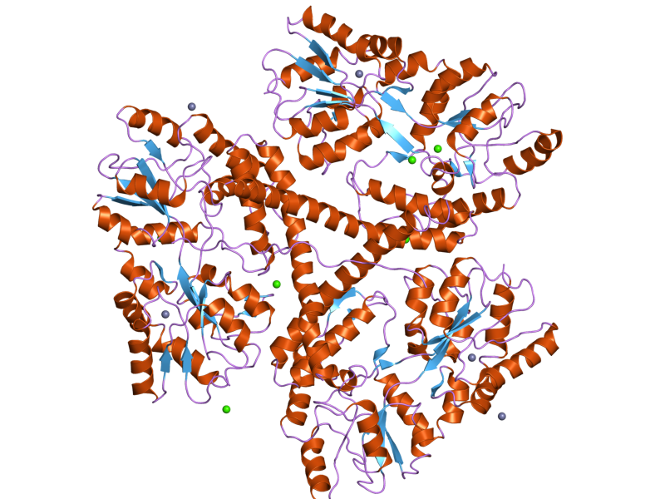
Biomarker Strategy Overview
To be updated/confirmed by Amanda and Rosa
 | Right Patient | Right Molecule | Right Target
 | Patient stratification Patient selection Prognostic | Target engagement (TE) Pharmacodynamic (PD) Safety | Disease progression
Phase 1 MAD (Healthy volunteers) |  | Direct TE: Whole Blood HTT RNA/protein
Phase 2/3 (HD patients) | Selection: CAG repeat length ≥40 | Direct TE: Whole Blood HTT RNA/protein Indirect TE: CSF HTT RNA/protein Safety: MRI | Disease: Neurofilament in CSF vMRI (striatal brain atrophy)

Slide 34
Summary of Stage Gate Criteria
Operational:
Re-assess core team, including RDPL
Refresh Therapeutic Concept
Target Candidate Profile should be updated by team
Biology:
Refined understanding of target distribution
Any genetically modified animal models have been requested
Pharmacology:
All hits have been fully validated
Compounds from similarity searches have been fully validated
Chemistry:
Chemistry plan is established
Compounds exhibit adequate intrinsic potency or established SAR suggesting a viable path forward for improving activity
Representative compounds from the chemical series profiled for solubility, permeability and efflux, in vitro microsomal stability, plasma protein binding, and chemical stability at low pH.
Representative validated hits evaluated for selectivity
Hit series is synthetically modular
Scale up routes to access multi-gram quantities of key intermediates and building blocks available
In silico SAR enabling strategy is in place and predictions for physical chemical and ADME properties of lead series are available
Translational Medicine:
The translational medicine plan completed and reviewed at CERB
Plans to demonstrate preclinical and clinical TE and PD defined. If the preclinical biomarker is unsuitable for clinical development then a secondary biomarkermust also be identified for use in humans
Published or internal pharmacometric modelling identified
For targets with genetic support, resources identified to refine genotype-phenotype associations and prevalence of rare mutations
Safety:
Validated hits have been evaluated using in silico tools to look for potential safety alerts and toxicophores
Any non-standard assays that could mitigate identified safety risks are established
Clinical:
Clinical tractability updated by RU clinical lead in consultation with appropriate partner line representatives
Document availability/need for natural history or other external data prior to Phase 2
Document Secondary Indications: scope of work required to support selection
Proposed clinical Proof of Concept endpoints are defined
Evaluate status of potential registrational endpoints required to support regulatory approval
QMP updated by QM representative and RU Clinical and Biomarkers lead
Differentiation:
Engage NPC to confirm that therapeutic concept is consistent with disease area roadmap, where available
Update competitive intelligence searches in target area and disease
Complete a competitive intelligence assessment for hit series
Summarize stage gate criteria that have been met & outline those that have not been met.
Highlight risks (if any) & mitigation strategies associated with stage gate criteria that have not been met.

Slide 35
Strategy to Lead Op Entry
Summarize strategy to next stage gate, Lead Op entry
Highlight key GNG experiments to enable Lead ID exit, and Lead Op entry
Define success criteria to enable Lead ID exit, and Lead Op entry

Slide 36
Key Experiments to enable Lead OP entry
Demonstrate that Biogen’s HTT splice modulators lead to in vivo reduction of HTT in the CNS and periphery
Demonstrate similar or better ADME/safety for internal HTT splice modulators over competitors in key in vitro assays (micronucleus, Ames)
- With clear path forward for improvement if necessary
Demonstrate similar or better selectivity of internal HTT splice modulators over competitors
What we need for Lead Op:
RASL-seq/RNA-seq selectivity data for lead molecules
Good ADME and Kpuu properties (what are our criteria based on comp?)
In vivo PK/PD validation of internal lead(s) (are we setting any criteria?)
Pass key in vitro safety assays (micronucleus, AMES)
Safety/tox studies species ID (lack of HTT ss conservation)
Achieved PoB with at least 1 molecule from lead series
Borrow data from Branaplam/PTC and link our leads via comparison of PK/PD, potency, MedChem (showing how we're better)
Need additional discussion/alignment about need for efficacy study

Slide 37
Go/No Go decision tree for HTT SM splice modulators
Competitor in clinic
Yes
Trial readout:
Cmpd shown to be
Safe/Tolerated?
EOY or early 2023 3mo readout from PTC expected
No
Yes
Continue SAR with understanding of competition
Inflection Point:
Longer readout necessary to make G/NG call on safety?
Yes
No
Extended Trial readout:
Cmpd shown to be
Safe/Tolerated?
Stop
No
Yes
Continue SAR to identify cmpd that improves TI
Stop

Slide 38
Timeline to Lead Op Entry
Summarize timeline to next stage gate
Highlight timeline of key GNG experiments
Present ‘accelerated’ option

Slide 39
HTT SM Timeline to Lead OP entry
Q2 2022
Q3 2022
Q4 2022
Q1 2023
Q2 2023
Q3 2023
Q4 2023
Optimization of lead scaffolds, synthesis and ADME
Projected
Lead OP Entry
HTRF SAR assay support
MoA confirmation/studies (RT-ddPCR, mini-gene assay support)
RASL-seq assay development
OT analysis of lead compounds via RASL-seq
RNA-seq and OT analysis of lead compounds
Benchmark YAC128 PK/PD
In vivo PK/PD studies with lead compounds
G/NG In Vitro Safety Assessment
In vitro safety/tox
DRF mouse tolerability
BTMS (Med Chem)
BHTS
GTB
GTB / HTVC
NDRU / GTB / PB
NDRU / TIVS / DMPK
Preclin Safety
TIVS
Secondary confirmation of lead compounds (Biophysical binding, RNA/protein in HD cells)
Completion of YAC128 characterization study

Slide 40
Potential Accelerated HTT SM Timeline to Lead OP entry
Q2 2022
Q3 2022
Q4 2022
Q1 2023
Q2 2023
Q3 2023
Q4 2023
Optimization of lead scaffolds, synthesis and ADME
HTRF SAR assay support
MoA confirmation/studies (RT-ddPCR, mini-gene assay support)
RASL-seq assay development
OT analysis of lead compounds via RASL-seq
RNA-seq and OT analysis of lead compounds
RNA-seq and OT analysis of lead compounds
Benchmark YAC128 PK/PD
In vivo PK/PD
In vivo PK/PD studies with lead compounds
In vitro safety/tox
G/NG Safety Assessment
Initiated at-risk
Projected
Lead OP Entry
DRF mouse tolerability
BTMS (Med Chem)
BHTS
GTB
GTB / HTVC
NDRU / GTB / PB
NDRU / TIVS / DMPK
Preclin Safety
TIVS
Secondary confirmation of lead compounds (Biophysical binding, RNA/protein in HD cells)
Completion of YAC128 characterization study
Go fast timeline assuming early identification of potent, brain-penetrant compound with good selectivity

Slide 41
Resources to Lead Op Entry
Summarize resources to next stage gate
Highlight resources for key GNG experiments
Present resources required for ‘accelerated’ option

Slide 42
Resources to Lead Op Entry (DRAFT)
Line Function | Activities | Q2 2022 | Q3 2022 | Q4 2022 | Q1 2023 | Q2 2023 | Current Gap
NDRU | RDPL, RNA/protein confirmation assays for lead compounds in HD cells, in vivo PD study support | 1.25 | 1.25 | 1.25 | 1.25 | 1.25 | 0
BHTS | HTT HTRF SAR-driving assay and data upload | 1.05 | 1.05 | 1.05 | 1.05 | 1.05 | 0
Physical biochemistry | HTT binding assay development and support | 0.5 | 0.5 | 0.5 | 0.5 | 0.5 | 0
Medicinal Chemistry | Modelling, informatics, design, and compound synthesis | X + X external |  |  |  |  | 0
DMPK | In vitro and in vivo DMPK support | 0.25 | 0.25 | 0.25 | 0.25 | 0.25 | 0
Translational Biology | GTB: RASL-seq, RT-ddPCR, mini-gene reporter assay HTVC: RNA-sequencing and analysis TCS: Human iPSC-derived cell production TIVS: YAC128 mouse breeding, PK/PD study support | 0.8 0.1 0.4 | 0.1 0.4 | 0.1 0.4 | 0.1 0.4 | 0.1 0.4 | 0
Preclinical Safety | Evaluate in vitro and in vivo tox |  |  |  |  |  | 0
PMO | Program Management |  | 0.25 | 0.25 | 0.25 | 0.25
Total |  |  |  |  |  |  | 0

Slide 43
Decisions Requested
Repeat decisions requested: Stage gate & resources
Illustrate heatmap: Highlight priority, portfolio fit, and key program opportunities & challenges

Slide 44
HTT Small Molecule Splice Modulator Team Members
Function | Core | Extended
RDPL | Catherine Nezich
Disease Area Biology/RU, RED |  | Andreas Weihofen
In vitro Pharmacology/BTMS | Joe Santoro
In vivo Pharmacology/RU or COE, RED | Moore Arnold | Rachelle Driscoll
Clinical Medical Director/RU, RED |  | Rosalind Chuang
Translational Biology/COE, RED | Jessica Hurt / Joon Lee | Viraj Shah, Sandi Engle
Biomarkers/COE, RED |  | Amanda Edwards
Chemistry/BTMS | Magnus Pfaffenbach | Philippe Bolduc, Daniel Smith Chaofan Xu, Emily Peterson
Physical Biochemistry/BTMS |  | Linlong Xue, Rajesh Kumar
Preclinical Safety/GSRS |  | Colin Choi
Formulation |  | Chengxiang Liu
DMPK/BTMS |  | Mukesh Lulla
EEPC/Commercial |  | Mayank Saksensa / Collette Laflamme
Other internal contributors: RNA splice modulator working group led by Eric Stefan & James Harvey
External contributors: Marta Stebbeds (CRL Discovery UK)

Slide 45
Backup Slides
Utilize backup slides to go more in depth on any topics
Ideally backup slides should be organized with hyperlinks

Slide 46
HTT SM Splice Modulator Target Candidate Profile
Category |  | Specific Measure | Preferred Criteria | BIO-1755497 (Branaplam) | BIO-2006152 (PTC518 guess) | BIO-2184741 (Remix lead)
Potency |  | Protein / RNA lowering IC50 | <25 nM | 12 nM / 4.8 nM | 13 nM / 16 nM | 56 nM / ip
in vitro ADMET |  | H,RLM / H,Rheps (mL min⁻¹ kg⁻¹) | <20, <30 | 15.2, 31.2 / 9.3, 24 | <4.7,<10.7 / 3.8, 42.2 | <4.7,<10.7 / 8.0, 23.5
 |  | PPB Fu% (h, m, r) / BrPB (r) | >1 | 12.7, 9.6, 15.0 / 1.7 | 16.1, 13.6, 15.1 / 1.9 | 23.4, 19.0, 23.3 / 3.4
 |  | IC₅₀ CYPs, TDI (CYP) | >10 µM, no TDI | >10 (all), nd | >10 (all), nd | ip
 |  | Solubility [ELogD] | >20 µg/mL | 16.6 [1.0] | 25.5 [1.5] | 33 [1.8]
 |  | MDR1-MDCK / BCRP Efflux ratio | <8, <3 | 29 / 1.4 | 5.8 / 1.3 | 7.4 / 5.1
 |  | hERG inhibition IC₅₀ µM | >10 mM | 4.7 | >30 | >30
 |  | HepG2 Cytotox IC50 [GLU,GAL] | >1 mM | 0.07, 0.64 | 0.04, 0.31 | ip
Physicochemical Properties |  | MW / cLogP / PSA / pka / cnsMPO | <450, <3.5, <90, <10, >4 | 393 / 3.2 / 96 / 10.0 / 3.5 | 390 / 2.9 / 59 / 9.3 / 5.1 | 406 / 2.1 / 66 / 10.1 / 4.7
Selectivity & Safety |  | Kinome Scan at 1 mM | <80% binding | - | 1/468 (IRAK4) | -
 |  | Safety47 Panel (<1 µM) | <50% response | ROCK1: 0.58 µM | AChE: 0.33 µM | -
 |  | #DSG RNAseq (iPSC, 4x IC50) | <40 off targets | 66 | 44 | ip
 |  | Micronucleus | negative | - | in progress | -
 |  | FOXM1 off-target splicing IC50 | >10 fold | 67 nM (14x) | 66 nM (4x) | ip
 |  | Ames | negative | - | - | -
 |  | Phototoxicity | negative | - | - | -
 |  | Hepatotoxicity Hurelhuman | negative | - | - | -
 |  | Phospholipidosis | negative | positive | positive | -
Rat PK | IV, cassette | Cl (mL min⁻¹ kg⁻¹) | <30 mL/min/kg | 37 | 34 | 14
CNS PK | Kp_{u,u} | Rat Kp_{u,u} Infusion | >0.3 | 0.11 | 0.90 | 0.66
Mouse PK | PO | AUC(ng*h/mL), Cmax | %F>30%; T_{1/2} 3-8h | AUC_{inf}/dose = xx; Dose xx mg/kg, AUC_{inf} = xx ng*h/mL, %F = xx | AUC_{inf}/dose = xx; Dose xx mg/kg, AUC_{inf} = xx ng*h/mL, %F = xx
Peripheral PD | Mouse | RT-ddPCR, whole blood HTT canonical/poison | 50% lowering | pEC₅₀ = xx nM, xx% lowering @ xx mpk SC; Cu_{p} = xx WB IC₅₀ | pEC₅₀ = xx nM, xx% lowering @ xx mpk SC; Cu_{p} = xx WB IC₅₀
cnsPD | Mouse | RT-ddPCR, Cortex HTT canonical/poison | 50% lowering | PPB_{corr} Brain EC50 = XX; xx0% inhibition @100 mpk (120 min); Cu_{brain} = xxx IC₅₀ | PPB_{corr} Brain EC50 = XX; xx0% inhibition @100 mpk (120 min); Cu_{brain} = xxx IC₅₀
human dose (estimated) |  | Estimated using mHTT IC50 | PO, QD 50% KD at Cmin | 56-154 mg weekly | 5-10 mg QD
Notes:
List of DAMPs: nuclear proteins (HMGB1), HSPs, ATP, nucleic acids, heme and fibrin (plasma proteins)

Slide 47
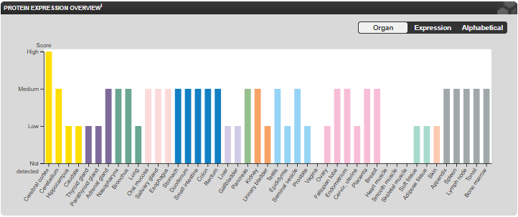
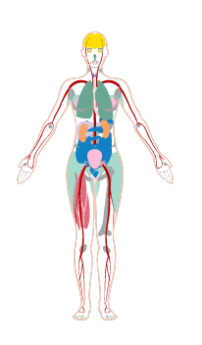
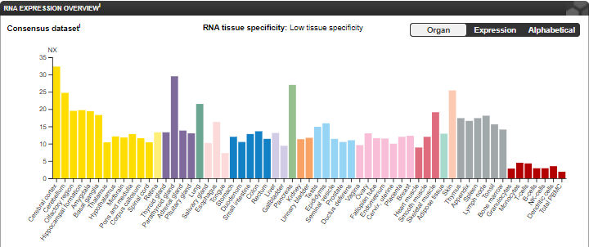
HTT RNA and protein is ubiquitously expressed across tissues
Notes:
Graphic:
Expert Review of Neurotherapeutics 2019 - Emerging therapies in Huntington’s disease: https://www.tandfonline.com/doi/abs/10.1080/14737175.2019.1631161
Review Articles:
Nature 2018 - Therapeutic approaches to Huntington disease: from the bench to the clinic: https://www.nature.com/articles/nrd.2018.133
Neuron 2019 - Huntingtin Lowering Strategies for Disease Modification in Huntington’s Disease: https://www.cell.com/neuron/pdf/S0896-6273(19)30066-2.pdf
Expert Review of Neurotherapeutics 2019 - Emerging therapies in Huntington’s disease: https://www.tandfonline.com/doi/abs/10.1080/14737175.2019.1631161
Cowen TA Outlook (Feb 2020)

Slide 48
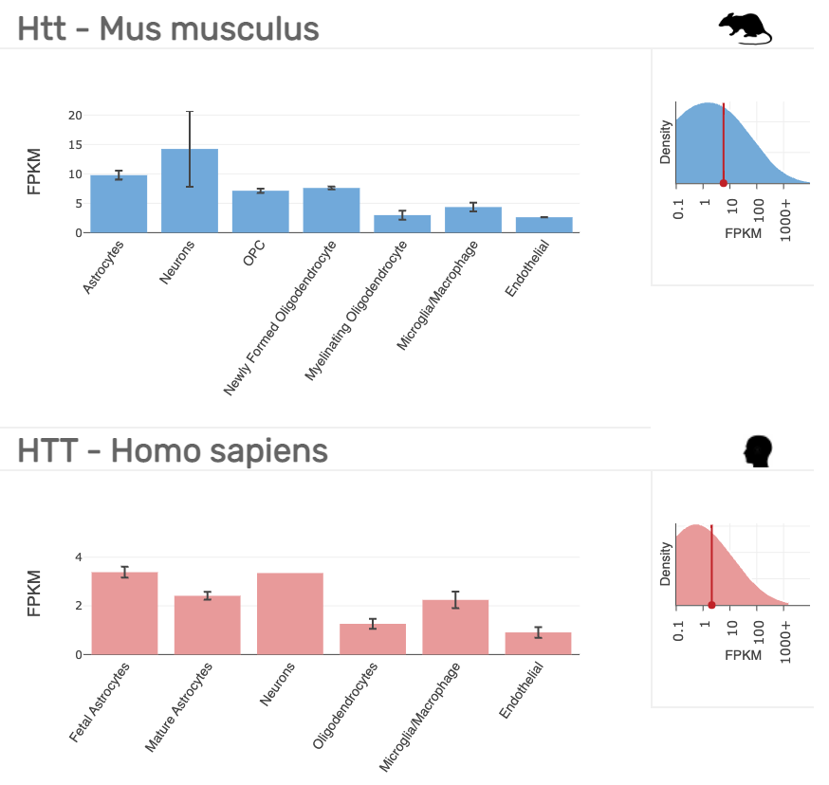
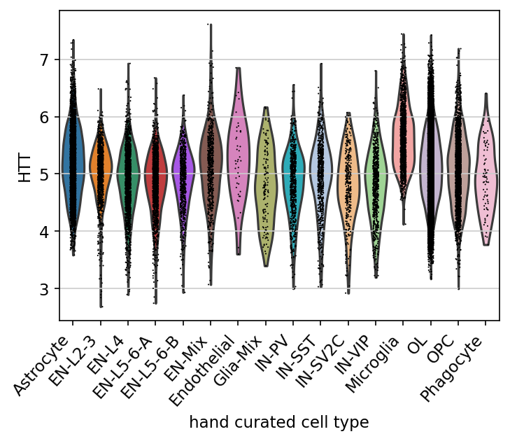
HTT RNA is ubiquitously expressed in all CNS cell types
HTT
nlog expression
Samples: snRNA-seq white matter from cortex of Control individuals (tissue: ICL)
Data acquisition/Analysis: Biogen, Cellxgene VIP
Barres RNA-seq
Notes:
https://www.brainrnaseq.org/

Slide 49
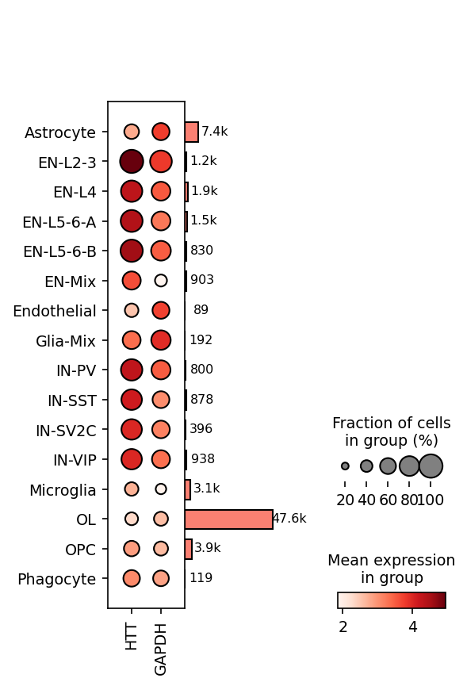
HTT RNA is ubiquitously expressed in all CNS cell types
Number of cells
EN: excitatory neuron
IN: inhibitory neuron
OL: oligodendrocyte
OPC: oligodendrocyte precursor cell
Barres RNA-seq
Samples: snRNA-seq white matter from cortex of Control individuals (tissue: ICL)
Data acquisition/Analysis: Biogen, Cellxgene VIP
Notes:
https://www.brainrnaseq.org/

Slide 50
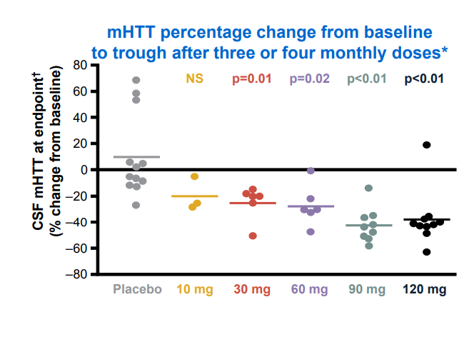
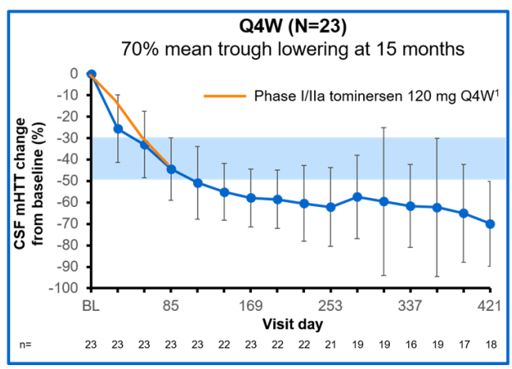
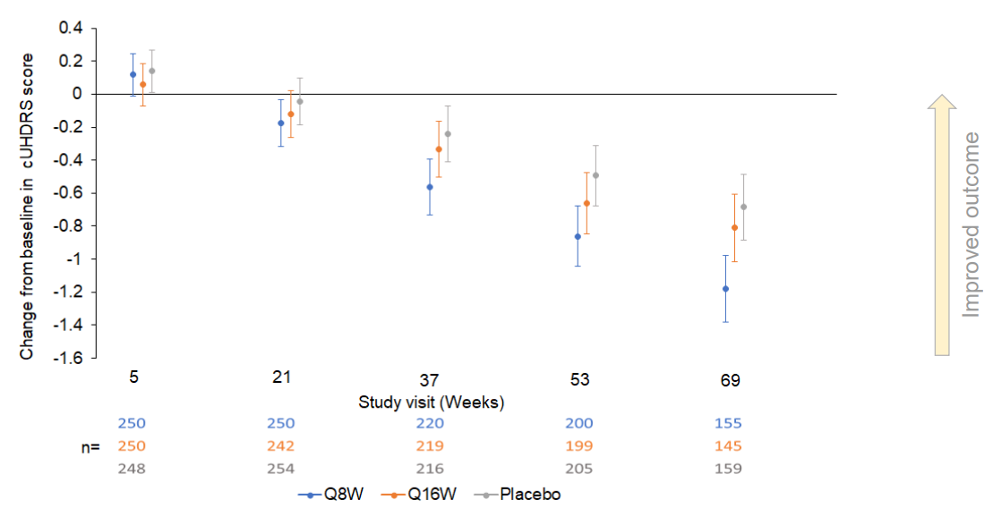
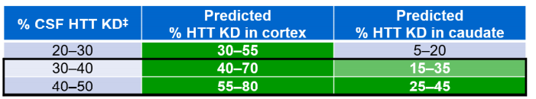
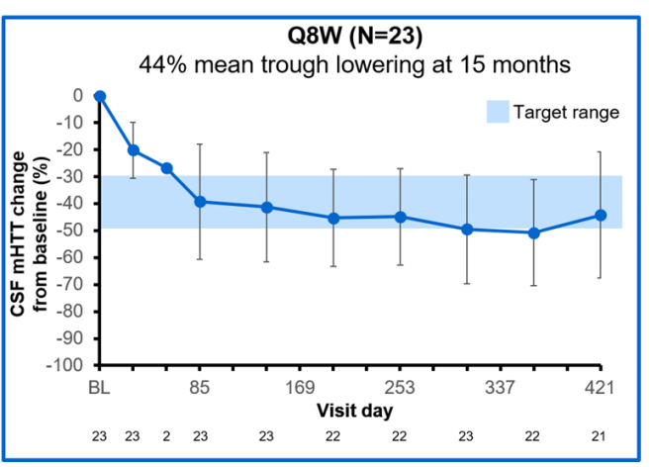
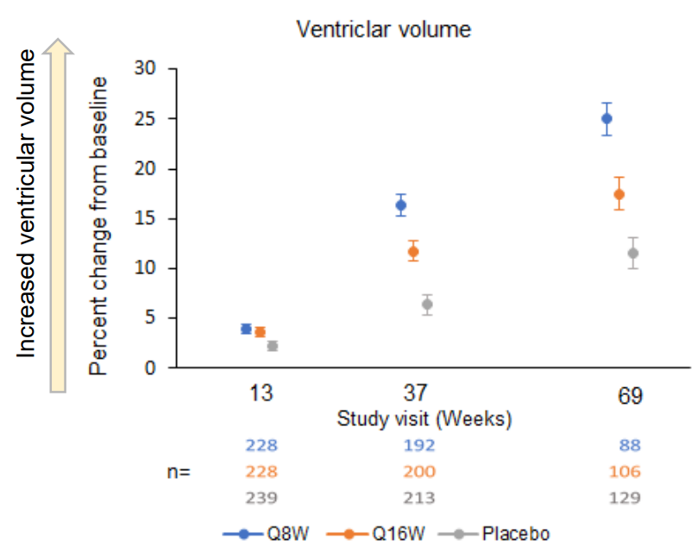
Key Question: What level of HTT reduction is necessary for therapeutic benefit?
Phase I/IIa
OLE
Phase III
cUHDRS
Four monthly doses were safe and well tolerated
High doses achieved 40% mean CSF HTT lowering, within putative trough target and range to cover deep brain regions
Notes:
CHDI 2021 presentation

Slide 51
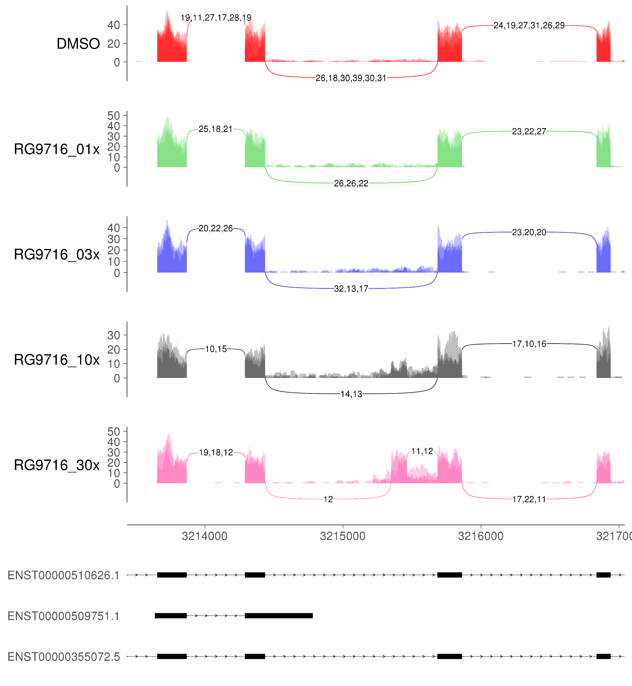
Serendipitous identification of SM-dependent cryptic exon in HTT gene
HTT coverage in Risdiplam treated MNs RNA-seq data
Event consistent in 3/3 SMA iPSC-MN lines at 400nM, and led to reduced HTT expression
Inclusion predicted to lead to premature termination codon (PTC)
5’ss follows “NGA” motif similar to SMN2 E7
DMSO
[Risdiplam]
5’ss
ENSMBL
Strategy: Cryptic exon usage predicted to trigger NMD and protein lowering
HTT mRNA
48
49
50
51
Exon 48
Exon 49
NMD Exon
Exon 50
Exon 51
TST11451- SMA SM
Notes:
Upon deeper analysis, we found that the 5’ss between exons 49 and 50 contains that same “NGA” motif that is observed for SMN2 exon 7, supporting our prior determination that this splicing modulation activity is sequence specific for this SM and suggesting a similar mechanism of action.
SMN2 E7 5’ss: GGAGTAAGT

Slide 52
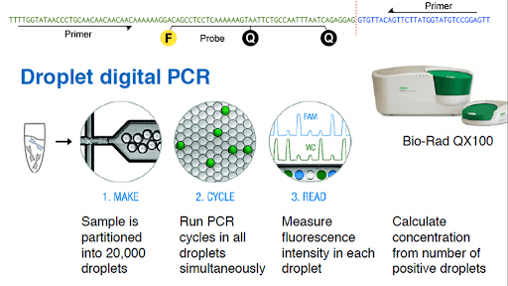
Droplet Digital PCR for direct quantification of sample DNA/RNA
1) Each molecule of DNA/RNA contained sample is partitioned into a large number of nanoliter sized droplets
2) Each droplet becomes an individual PCR reaction
3) Fluorescence is detected in the droplets in which target sequence was amplified (positive)
4) Using Poisson distribution law, the fraction of positive droplets is converted to the number of molecules in the starting sample
Unlike qPCR, there is not a need to generate a standard curve since ddPCR simply counts the number of target molecules contained in the sample as the results are expressed as copies per microliter.

Slide 53
IC50 Correlations
Needs update

Slide 54
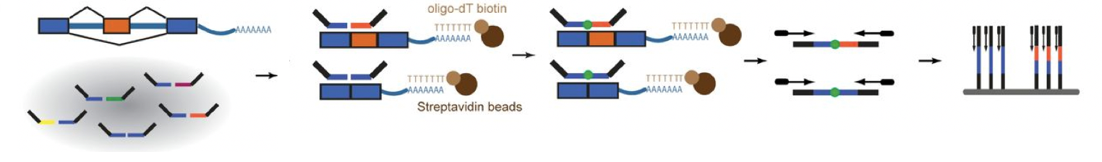
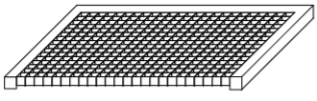
Intended strategy to parallelize off-target assessments
Internal RNA-seq with Risdiplam and Branaplam have informed on potential off-targets (>50)
Traditional qPCR-based approaches are not cost-effective to monitor this many events at once
RASL-Seq currently under testing to assess suitability for parallelized assessment
RNA-seq
RASL-seq
qPCR
Unbiased discovery
Transcriptome-wide at high cost/sample
Panel-based query
100’s of targets at low cost
$1-2/sample
>
Single event query
Few targets at low cost/sample
Known splicing events
Cell lysis
Probe annealing
Ligation
PCR
Sequencing
Scekic‐Zahirovic et al. 2016
RNA-Mediated Oligonucleotide Annealing, Selection, and Ligation with Next-Generation Sequencing
Notes:
Advantages:
Measure gene expression and/or splicing events (>100);
Effective on low total RNA amounts (10 ng or ~ 1000 cells);
Can be performed directly on cell lysates from 384-well culture plates;
Can be automated using a custom robot;
Based on shallow sequencing of crude cell lysates;
Low cost ($1- 4 per sample including sequencing).

Slide 55
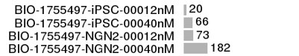
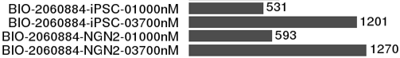
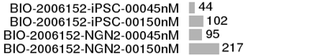
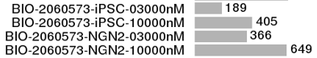
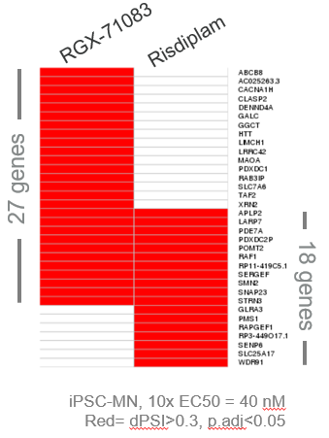
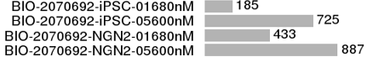
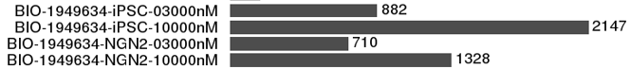
Number of differentially spliced genes from RNAseq analysis
Concentrations very high: 3x and 10x HTT IC50 doses used
55

Slide 56
FOXM1
Risdiplam and branaplam affects splicing of exon 9 (or exon VIIa or exon A2)
GM09677
Ando et al., 2021
Most abundant
Active
Least abundant
Active
Truncated protein
Full-length
Inactive
Dominant-negative
Aberrant FOXM1 splicing found in studies with Risdiplam hypothesized as source of micronucleus formation (Ratni et al., J. Med. Chem. 2018)
FOXM1 exon 9
Blue= Risdiplam
Cyan= Branaplam
Black= Vehicle
56

Slide 57

Additional sequence elements are required for selectivity
Risdiplam binds to two sites within SMN2 exon 7, namely, ESE2 and 5′ss, facilitates splicing promotion and exon 7 inclusion in the mature transcript. Binding to the 5′ss favors U1 snRNA binding, and interaction with the exon 7 ESE2 is believed to result in hnRNP G dislocation to allow binding of the U1 snRNP complex. The combination of both binding processes provides high selectivity for the SMN2 pre-mRNAs.
57

Slide 58



SM can provide improvements in distribution and ROA over other therapies
F18-FDG PET
Good exposure to key brain regions
Dose tuning to maximize therapeutic effect over side effects
Potential for long-term/prophylactic dosing
Potential for combination therapy
Potential to treat both CNS and peripheral symptoms of HD
(van den Burg et al., The Lancet Neurology, 2009)
Notes:
Unlike ASO’s small molecules have been shown to have good exposure in all regions of the brain
This may allow us to target > 15-45% exposure in the caudate.
Oral dosing allows for dose tuning to allow for the maximal possible therapeutic index.
Potential for long-term/prophylactic dosing and even combination therapy
Oral SM also have the potential to treat both CNS and peripheral symptoms of HD
So, Despite this being a pan-HTT lowering MoA, these advantages of an oral disease-modifying therapy for patients boosts the rationale further for this program
Peripheral pathology:
Changes are not all secondary to brain dysfunction, but directly caused by expression of mutant huntingtin in peripheral tissues
Most common are metabolic symptoms, which include weight loss, endocrine dysfunction, and sleep disturbance
Other peripheral symptoms often reported are cardiac failure, skeletal muscle and testicular atrophy, and osteoporosis

Slide 59

Comparison of full length HTT transgenic mice with human patient
Notes:
Such models express human genomic mutant HTT transgenes, including all the introns and exons as well as the regulatory sequences up to 24 kb upstream and 117 kb downstream of the gene, ensuring appropriate temporal and tissue-specific expression of mHTT
YAC128 HD mice express mutant HTT with 128 CAG repeats54, whereas BACHD mice and rats express mutant HTT with 97 CAG repeats55,56. The YAC128 and BACHD mice show limited somatic and germline repeat instability (V. Wheeler, personal communication)55.
Although the BACHD and YAC128 models share many phenotypic characteristics, there are notable differences between them, including divergent neurochemical and aggregation phenotypes60.

Slide 60


Slide 61





PD of PTC518 in the BACHD mouse model
Update and include PTC sad/mad
PTC518 predicted to achieve equivalent HTT mRNA
and protein reductions at steady state
Dose dependent HTT lowering in the brain
~50% HTT lowering in all regions of the brain with a 7 mg/kg dose with ~1:1 brain/blood concentrations
Notes:
evaluating huntingtin lowering activity of PTC518 in blood will serve as a surrogate for huntingtin-lowering in the brain

Slide 62







PD/efficacy of Branaplam in the BACHD mouse model
Add recently published behavior data
Branaplam (WB Brain)
3 or 10 mpk QD for 14 days
Effects are reversible as protein levels
return within 10 days of treatment cessation
~50% mHTT lowering in the brain resulted in near depletion (>90%) in peripheral tissues
→ reported to cause acute pancreatitis due to degeneration of pancreatic acinar cells
Branaplam (WB Brain)
Days @ 10 mpk
Uniform >50% mHTT protein-level lowering across brain regions
Notes:
50% lowering in the brain resulted in near depletion of mHTT (>90%) in peripheral tissues. Ablation of wt HTT in mice has been reported to cause acute pancreatitis due to degeneration of pancreatic acinar cells

Slide 63
Proposed Timeline??
Asked for LOE date estimates from Josh Galgano
2023
Proposed LeadOP transition for Biogen HTT SM
2021
HTT SM program entered Hit ID
2038-2040
Branaplam/PTC518 loss of exclusivity
We are here
Clinical Trials
2022
Proposed initiation date for LeadID Biogen HTT SM
2024
Proposed R2D transition for Biogen HTT SM only if meets TPP criteria
20XX (-3 yr?)
Proposed Phase III readout on
Biogen HTT SM

